Slide 1
Project– update
18 May 2016

Slide 2
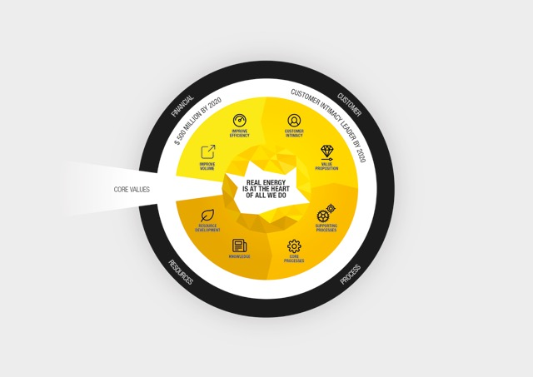

Strategy – update
...Explore our Corporate strategy by clicking one of the strategy perspectives
You will get the following site → Pop Up incl content
....Or click on the values to get some more info on the values and success stories related to corporate values

Slide 3
Welke onderdelen moeten er precies dynamisch zijn?
Onderdelen met icontjes en tekst dus allemaal
Hulptekst als in het witte deel (links) met Core values?
Niet per se… Mag ook in een andere subtiele format. Het moet een soort quick reference zijn
Moeten er links komen op alles vlakken met een verwijzing naar een lijst/site/document?
Ja, link naar een lijst of een site! Een soort Pop up met content.
Waar komt dit voorbeeld vandaan, van Energyst zelf of internet?
Dit is een Energyst design. Indien gewenst kan ik het design in verschillende formatten opvragen.
Hover animatie
Als de gebruiker over design hovert dan komt een van de onderdelen naar boven en wellicht een hulptekst laat zien
Andere suggesties zijn ook welkom

Slide 4
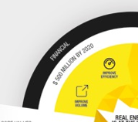



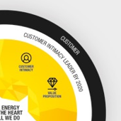



Strategy Map - objectives
Financial strategic objectives 2016:
Ensure that we have a balanced and managed risk portfolio
Design and implement a risk management model to analyse and report important project risks and find mitigating actions
Balance 2016 growth between Standard Solutions and Custom Solutions
Maintain profitability in Europe through strategic choices
Develop and execute a plan to ensure profitability in UK & I
Develop and execute a plan to optimize performance in Germany, Sweden and Norway
Secure financial covenants and funding
Develop and execute a plan to manage and secure needed funding
Improve Alignment and Direction especially related to Compliance
Introduce Monthly BU reviews rotating per BU, on location with local Leadership Teams and ensure Compliance Review is a mandatory item on the agenda
Read how Jos, Operations contributed to our Financial objectives
Highlighting pictograms...
Read how Eddy, Sales Mgr contributed to our Financial objectives
And you?
Strategic Financial KPI’s | Objective | Quick description
GFU | 60% by end 2016 | Gross Financial Utilization: #revenue created/potential revenue
Questions? Contact your line manager or send your email to gary.smith@energyst.com

Slide 5
Strategy Map - objectives
Customer strategic objectives 2016:
Sales Effectiveness
Establish an effective Market Intelligence system.
Execute phase 1 of the O&G plan
Coordinate the formulation and execution of a sales plan (by PMC) per BU, including:
KPI’s, (€, # of visits) measured on CRM
Pricing,
Revenue Targets with required conversion rates
5 year forecasts.
Instill and Nurture the “Sales DNA” through:
Value selling behaviors
Various sales behavior expectations
Sales oriented mindset
Implement a Pricing Management Model
Define the parameters for Renewable Solutions
Define the products for the Renewable Solutions market (Specifically Solar/Thermal Hybrids and Micro grids), in terms of technical, commercial and financial
Build top-of mind Brand awareness through REAL ENERGY
Enhance Energyst Brand visibility online, offline and via personal interaction
Read how Jos, Operations contributed to our Sales objectives
Highlighting pictograms...
Read how Eddy, Sales Mgr contributed to our Sales objectives
And you?
Key Sales KPI’s & BHAG’s | objective | Quick description
Nett promoter Score | 66% | Tet e e et e e
Revenue | 230 million EUR by 2020 | Feeez ret rer t
Questions? Contact your line manager or send your email to gary.smith@energyst.com

Slide 6

Site Content
Job Name | Job Mission | KPI’s |  | ISO documents
Fleet Director | To ensure deployment takes place by providing fleet needed when required at appropriate standard and provide all related support to Energyst | TU |  | E OPS 01 1St Line Maintenance R2R procedure
Fleet development Manager | To provide fleet related services to the Energyst community so that optimum standards in fleet costs availability, quality and innovation enable the delivery | Ready to Rent |  | E OPS 02 Fuel Tanks ADR Certification Procedure
Fleet Ops | To ensure deployment takes place by providing the fleet needed when required at appropriate standard and provide all related support |  |  | E OPS3 Annual Electrical Distribution Equipment Certifiaction

